Slide 1
Face Recognition

Slide 2
Objectives
What is Face Recognition?
The techniques used in face recognition.
What are the future of face recognition?
Applications of face recognition

Slide 3
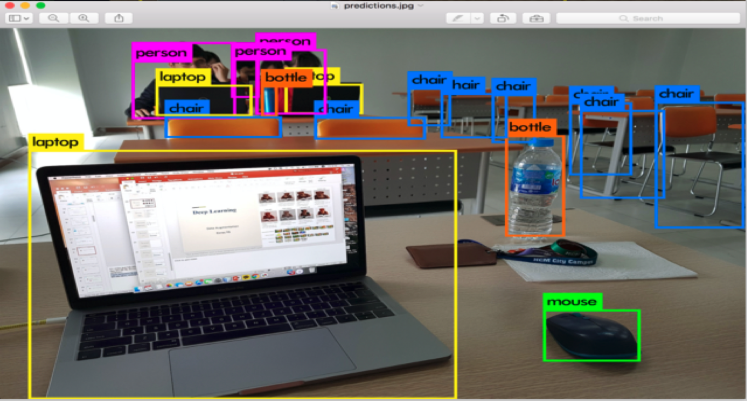
What is Object Recognition?

Slide 4
What is Object Recognition?
Object recognition is the ability to recognize an object.
Object recognition consists of recognizing, identifying, and locating objects within a picture with a given degree of confidence.
This might be after the object has been previously seen or recognizing it from photographs.
It is the ability to perceive an object’s physical properties (such as shape, color, and texture) and apply semantic attributes to the object

Slide 5
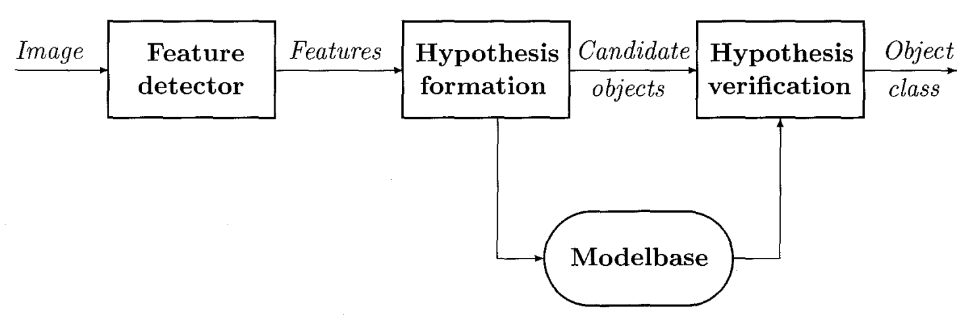
Object Recognition

Slide 6
Object Recognition Steps
Feature extraction: Which features should be detected, and how can they be detected reliably?
Feature-model matching: How can features in images be matched to models in the database?
Hypotheses formation: How can a set of likely objects based on the feature matching be selected, and how can probabilities be assigned to each possible object?
Object verification: How can object models be used to select the most likely object from the set of probable objects in a given image?

Slide 7
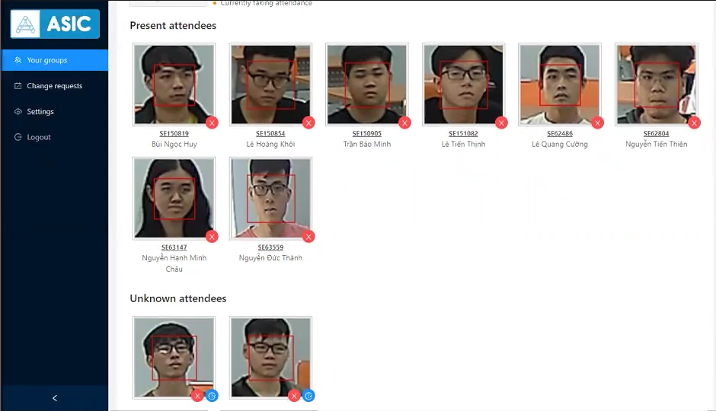
Face Recognition

Slide 8
Face Recognition
Facial recognition is a way of identifying or confirming an individual’s identity using their face.
Facial recognition systems can be used to identify people in photos, videos, or in real-time.
Facial recognition is a category of biometric security
Voice recognition
Fingerprint recognition
Iris recognition.

Slide 9
How does it work?
Step 1: Face detection: detects and locates the image of a face
Step 2: Face analysis: image of the face is captured and analyzed
Step 3: Converting the image to data: the face capture process transforms analog information (a face) into a set of digital information (data) based on the person's facial features.
Step 4: Finding a match: Your faceprint is then compared against a database of other known faces

Slide 10
How does it work?
Step 2: Face analysis
Reads the geometry of your face.
Key factors include:
The distance between your eyes.
The depth of your eye sockets
The distance from forehead to chin
The shape of your cheekbones, and the contour of the lips, ears, and chin.
The aim is to identify the facial landmarks that are key to distinguishing your face.

Slide 11
The Approach
Type 1: Holistic Matching Methods: The approach covers face recognition as a two-dimensional recognition problem. Example: Eigenfaces, Principal Component Analysis, Linear Discriminant Analysis, and independent component analysis
Type 2: Feature-based Methods: In this method, local features such as eyes, nose, and mouth are first of all extracted and their locations and local statistics are fed into a structural classifier.
Type 3: Hybrid Methods: use a combination of both holistic and feature extraction methods

Slide 12
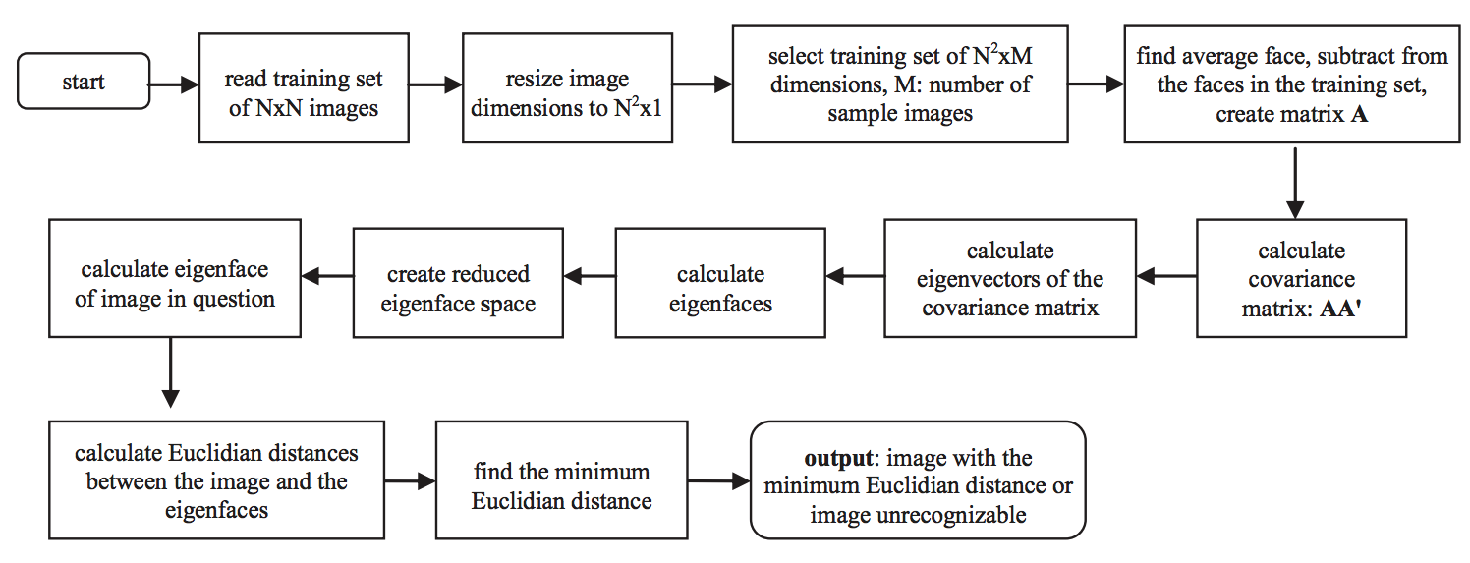
Eigenfaces method
Facial

Slide 13
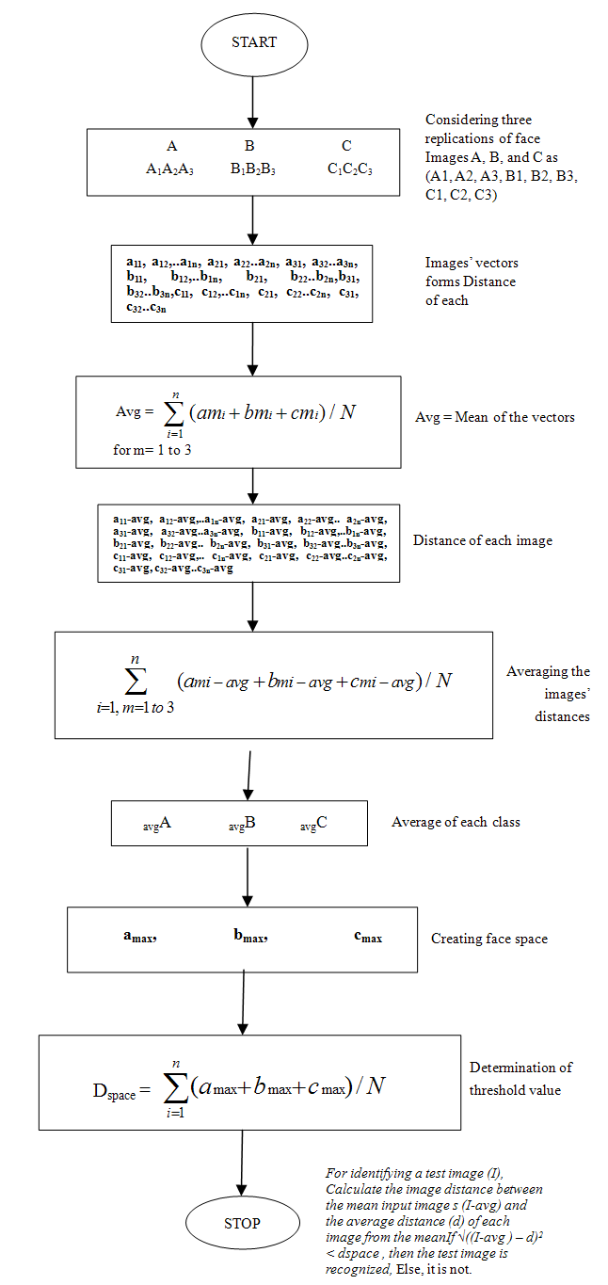
Eigenfaces method
PCA Steps

Slide 14
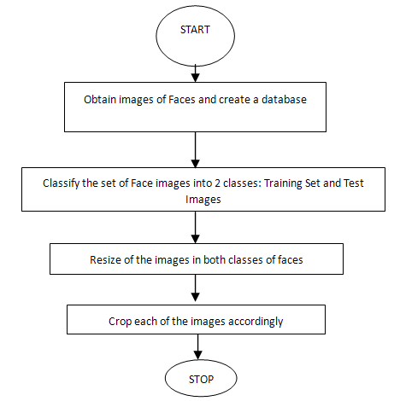
Eigenfaces method
Pre- Processing Flowchart

Slide 15
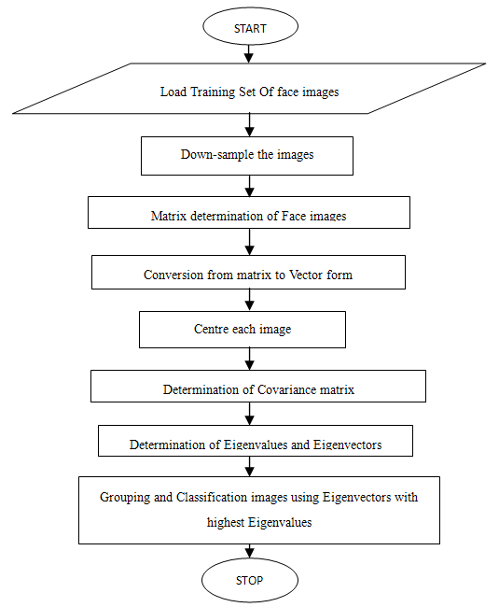
Eigenfaces method
Trainning of face images

Slide 16
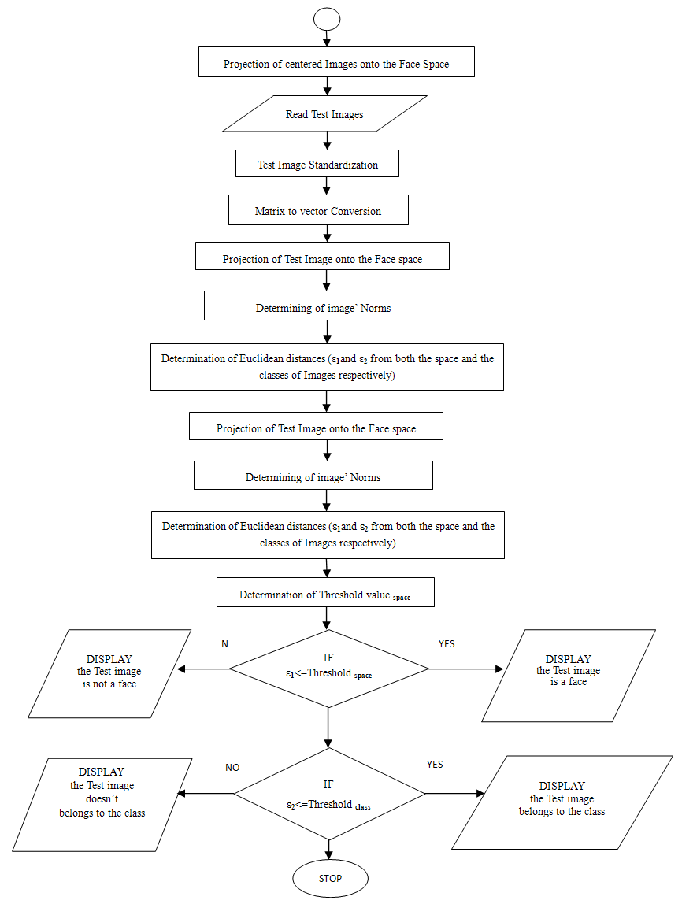
Eigenfaces method
Recognition

Slide 17
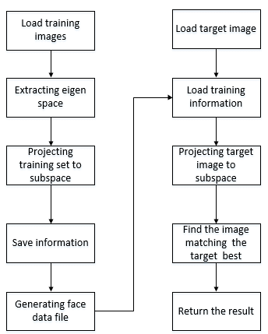
Eigenfaces- Face Recognition
Summary

Slide 18
Applications
Prevent Retail Crime.
Unlock Phones.
Smarter Advertising.
Find Missing Persons.
Help the Blind.
Protect Law Enforcement.
Aid Forensic Investigations.
Identify People on Social Media Platforms.

Slide 19
Summary
What is Face Recognition?
The techniques used in face recognition.
What is a feature of face recognition?
Applications of face recognition

